Slide 1
Graph-Based Protocol
KYRSHANLANG R DKHAR

Slide 2
Contents
What is Graph-Based Protocol
Example of Graph-Based Protocol: Tree-protocol
Rules in Tree Protocol
Example of transactions with help of tree protocol
Advantages
Disadvantages
Bibliography

Slide 3
What is Graph-Based Protocol?
Graph-Based Protocol is a lock based concurrency control mechanism that ensure serializability.
Graph-based protocol is an alternative to two-phase locking protocol.
It requires prior knowledge about the order in which the database items will be accessed.

Slide 4
What is Graph-Based Protocol?
We impose a partial ordering → on the set D
D = {d₁, d₂, . . ., d_{h}} of all data items.
If d_{i} → d_{j} , then any transaction accessing both d_{i} and d_{j} must access d_{i} before accessing d_{j} .
This implies set D may now be viewed as a directed acyclic graph, called database graph.
The tree-protocol is a simple kind of graph protocol.
In the tree protocol, the only lock instruction allowed is lock-X.

Slide 5
Rules in Tree Protocol
Each transaction T_{i} can lock a data item at most once, and must observe the following rules:
The first lock by T_{i} may be on any data item.
Subsequently, a data item Q can be locked by T_{i} only if the parent of Q is currently locked by T_{i} .
Data items may be unlocked at any time.
A data item that has been locked and unlocked by T_{i} cannot subsequently be relocked by T_{i} .

Slide 6
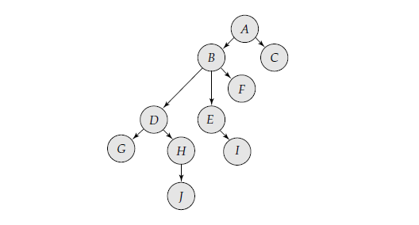
Example
Let us consider a database D= {A,B,C,D,E,F,G,H,I,J }. Database Graph:-

Slide 7
Example
The following transactions follow the tree protocol on the previous graph (showing only lock and unlock operations)
T10: lock-X(B); lock-X(E); lock-X(D); unlock(B); unlock(E); unlock-X(D);
T11: lock-X(D); lock-X(H); unlock(D); unlock(H).
T12: lock-X(B); lock-X(E); unlock(E); unlock(B).
T13: lock-X(D); lock-X(H); unlock(D); unlock(H).

Slide 8
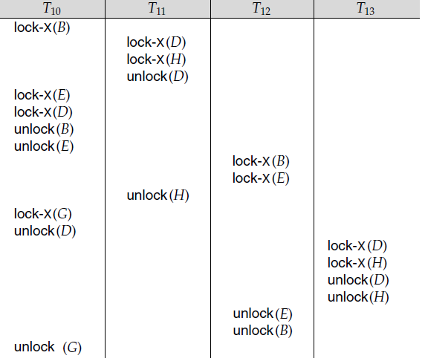
Serializable schedule under the tree protocol

Slide 9
Tree Protocol
Here the tree protocol does not ensure 1.Recoverability and
2.Cascadelessness
But if the protocol can be modified to not permit release lock until the end of transaction ,then it ensure Recoverability and Cascadelessness.

Slide 10
Advantages
The tree protocol ensures conflict serializability
Freedom from deadlock.
No rollback, since there is no dirty read problem.
Unlocking may occur earlier in the tree-locking protocol than in the two-phase locking protocol.
shorter waiting times, and increase in concurrency
protocol is deadlock-free, no rollbacks are required

Slide 11
Disadvantages
In the tree-locking protocol, a transaction may have to lock data items that it does not access.
increased locking overhead, and additional waiting time
potential decrease in concurrency
Prior knowledge of data access is required

Slide 12
Bibliography
Database System Concepts, Fourth Edition By Silberschatz−Korth−Sudarshan
Graph Based Protocol https://www.youtube.com/watch?v=1WYGE_BBYtY
www.techtud.com/video-lecture/understanding-graph-based-protocol

Slide 13
THANK YOU

Slide 14
Let two transaction T1 and T2 are defined as
T1: Read(A) T2: Read(A)
A:=A-50 temp:=A*0.1
Write(A) A:=A -temp
Read(B) write(A)
B:=B+50 read(B)
Write (B). B:=B+ temp
write(B).

